Slide 1
01 | Design big data real-time processing solutions
Andy Roberts | Data Platform Specialist, Microsoft Northeast

Slide 2
In this module
Lambda Architecture
Event Hubs & Kafka
Storm
Stream Analytics
Spark

Slide 3
In this module
Lambda Architecture
Event Hubs & Kafka
Storm
Stream Analytics
Spark

Slide 4
Big Data Lambda Architecture Meant to be generic, fault tolerant and outwardly scalable to support a wide range of workloads and use cases.
Batch layer
Stores master dataset
Compute arbitrary views
Speed layer
Fast, incremental algorithms
Batch layer eventually overrides speed layer
Serving layer
Random access to batch views
Updated by batch layer
Batch Layer
Speed Layer
Serving Layer
Notes:
Talk Track: In order to make sense of how various Big Data technologies fit together, the Open Source community has developed what is know as the Big Data Lambda Architecture. The “lambda architecture” provides an architectural model that scales and which has both the advantages of long-term batch processing and the freshness of a real-time system, with data updated in seconds time. The lambda architecture solves the problem of computing arbitrary functions on arbitrary data in real time by decomposing the problem into three layers: the batch layer, the speed layer, and the serving layer.
Let’s take a look at each of the three layers.
The Batch Layer stores the Master Dataset for you solution – typically in append mode – that is handles new data coming in. The Batch layer is usually: Read only database. No random writes required. It is Horizontal scalable with unrestrained computation and High Latency.
Speed Layer - Stream processing and Continuous computation. It provides fast incremental algorithms. Batch layer eventually overrides speed layer. All the complexity is isolated in the Speed layer. If anything goes wrong, it’s auto-corrected. The views are stored in Read & Write database.
• MS SQL Server
• Column Store
• Cassandra
• …
• Much more complex than a read only view.
Service Layer: The service layer provides the merged outcome of data streams coming from the Batch layer and the speed .This layer queries the Batch & Real Time views and merges it. PolyBase is a great fit.
Key Points:
Lambda Architecture with three layer
The Batch Layer -Stores Master Dataset
The Speed layer –Stream Processing for real time view
The Service Layer-merged outcome of data streams coming from the Batch layer and the speed layer
References:
Big Data Lambda Architecture: http://www.databasetube.com/database/big-data-lambda-architecture/
Speaker notes from: http://sqlug.be/files/sqlug/bd/MicrosoftBigDataSQLUG.pdf

Slide 5
The Batch Layer
Stores master dataset (in append mode)
Unrestrained computation
Horizontally scalable
High latency
Batch views
Master
dataset
Incoming data streams
Notes:
Talk Track: The portion of the lambda architecture that precomputes the batch views is called the batch layer. The batch layer stores the master copy of the dataset and precomputes batch views on that master dataset. The master dataset can be thought of us a very large list of records. The batch layer needs to be able to do two things to do its job: store an immutable, constantly growing master dataset, and compute arbitrary functions on that dataset. The key word here is arbitrary. If you’re going to precompute views on a dataset, you need to be able to do so for any view and any dataset.
The nice thing about the batch layer is that it’s simple to use. Batch computations are written like single-threaded programs yet automatically parallelize across a cluster of machines. This implicit parallelization makes batch layer computations scale to datasets of any size. It’s easy to write robust, highly scalable computations on the batch layer.
The batch view enables you to get the values you need from it very quickly because it’s indexed.
Think of technologies like Hadoop and Pig/Hive for use on the Batch layer. Data warehouse database technologies can also be associated with the Batch layer.
Key Points:
The Batch Layer -Stores Master Dataset and precomputes batch views on that master dataset
Store an immutable, constantly growing master dataset, and compute arbitrary functions on that dataset
Read only database. No random writes required.
References: Big Data Lambda Architecture: http://www.databasetube.com/database/big-data-lambda-architecture/

Slide 6
The Speed Layer
Process Stream of Data
Store Window of Data
Compute Dynamically
Real-time views
Incoming data streams
Process stream
Increment views
Real-time increments
Notes:
Talk Track: You can think of the speed layer as similar to the batch layer in that it produces views based on data it receives. There are some key differences, though. One big difference is that, in order to achieve the fastest latencies possible, the speed layer doesn’t look at all the new data at once. Instead, it updates the real-time view as it receives new data instead of recomputing them like the batch layer does.
The speed layer requires typically requires databases that support random reads and random writes. Because these databases support random writes, they are more complex than the databases you use in the serving layer, both in terms of implementation and operation.
Most of the application complexity tends to be isolated in the Speed layer.
Technologies typically considered for the speed layer include in-memory transaction databases and complex event processing engines.
Key Points:
Stream processing.
Continuous computation
Transactional.
Storing a limited window of data. Compensating for the last few hours of data.
All the complexity is isolated in the Speed layer. If anything goes wrong, it’s auto-corrected. Some algorithms are hard to implement in real time
References: Big Data Lambda Architecture: http://www.databasetube.com/database/big-data-lambda-architecture/

Slide 7
The Serving Layer
Queries the batch and real-time views
Merges the results
Batch views
Output
Querying and merging
Real-time views
Notes:
Talk Track: Finally, the serving layer indexes the batch view and loads it up so it can be efficiently queried to get particular values out of the view. The serving layer is typically considered as a specialized distributed database that loads in batch views, makes them able to be queried, and continuously swaps in new versions of a batch view as they’re computed by the batch layer. A serving layer database only requires batch updates and random reads. Most notably, it does not need to support random writes. The serving layer job is to queries the Batch & Real Time views and merges it.
Typically the technologies associated with the serving layer include on-line analytic processing databases like Analysis Services and PowerPivot. It can also be considered as the “last mile” technology for producing usable results for your solutions.
Key Points:
Service Layer queries the Batch & Real Time views and merges it
References: Big Data Lambda Architecture: http://www.databasetube.com/database/big-data-lambda-architecture/

Slide 8
Microsoft Lambda Architecture Support
Batch Layer
Speed Layer
Serving Layer
Azure HDInsight
Azure Blob storage
Azure Data Lake Store
Azure Data Lake Analytics
Azure SQL DW
MapReduce, Hive, Pig, Oozie
SQL Server Integration Services
Azure Data Factory
Azure Table Storage
CosmosDB(DocumentDB)
Memcached/MongoDB
SQL Server (Columnstore indexes, StreamInsight)
Azure Stream Analytics
Azure Event Hubs
Kafka
Storm
Azure Storage Explorer
Microsoft Excel
PowerBI
Power (Query, Pivot, View, Map)
Reporting Services
LINQ to Hive
Analysis Services
Notes:
Talk Track: The Microsoft’s Data Platform stack fully supports each of the layers in the Big Data Lambda Architecture.
For the batch layer, Microsoft provides multiple options for the storage and processing of batch oriented data. These include Windows Azure HDInsight and Azure Blob Storage to hold the input data. The SQL Server data warehousing capabilities can also be associated with the batch layer.
For processing the data and view management, Microsoft supports processing of Hadoop data through MapReduce jobs along with Hive, Pig, and Oozie. For data warehousing, you can use traditional SQL views and stored procedures.
For the speed layer, Microsoft supports real-time processing of data through technologies like Federations in Windows Azure SQL Database, Azure Tables, Memcached/MongoDB, SQL Server database engine and SQL Server VM along with Columnstore Indexes, Analysis Services, StreamInsight.
Finally, with the serving layer, which provides the merged outcome of data streams coming from the Batch layer and the speed layer, you can use tools like PowerPivot, Power View, Power Query, Power Map, Reporting Services, LINQ to Hive and Analysis Services technologies.
Key Points:
Microsoft provides a complete BI solution, which can be entirely aligned with all the three layers of the Lambda Architecture.
References: Big Data Lambda Architecture: http://www.databasetube.com/database/big-data-lambda-architecture/

Slide 9










Lambda on Azure Data Options
Information Management
Big Data Stores
Machine Learning
& Analytics
Data Consumption
Data Generation
Batch Layer (Cold Path)
Serving Layer
Azure Data Factory
Azure ML
Data Science VM
Databases
Azure Data Lake
Azure SQL Data Warehouse
Ad Hoc Dashboards
R
Power BI
Cortana
Web App
Excel
Perceptual
Intelligence
Azure Import/Export Svc
Spark
Pig
Azure Blob Storage
HDFS
Hadoop Interface
Apps
Hive
HBase
Automated Systems
Business
Custom
HDInsight Sqoop
Mahout
APIs
Business Scenarios
Speed Layer (Hot Path)
Power BI
Azure Event Hub
Azure Stream
Analytics
Big Data Sources
Devices
Azure SQL
DB
Azure
Web App
Crawlers
Storm
Bots
Kafka
Cosmos
DB
Hadoop
Streaming
Interface
Sensors
Spark
Streaming
Redis Cache
Legend
 | Azure |  | Cold Path
 | OSS on Azure |  | Hot Path

Slide 10
In this module
Lambda Architecture
Event Hubs & Kafka
Storm
Stream Analytics
Spark

Slide 11
Event Hubs
Managed Publish-Subscribe service
Ingests millions of events per second
Elastic scale
Connects disparate data sources
AMQP and HTTP support as well as native libraries for popular platforms

Slide 12
Event Hubs Conceptual Architecture
Azure Event Hub
Consumer Group
Partition 1
HTTPS
AMQP
Partition 2
Event Receivers
Partition 3
Consumer Group 2
Event Producers
Partition 4

Slide 13





Simplified analogy – A specific scenario
EH Times Inc.
Reporters (Senders)
Politics
Partitions
Finance
Consumer Group 1
EHPN sports website
Sport
Editor
Art
Active reader of a partition in a consumer group
Only 1 active reader at a time per partition per consumer group

Slide 14

Simplified analogy – A specific scenario
EH Times Inc.
Only 1 active reader per partition
Consumer Group 2
Editors
Newspaper
Reporters (Senders)
Politics
Partitions
Finance
Sport
Art
Editor (Reader)
EHPN sports website
Consumer Group 1

Slide 15
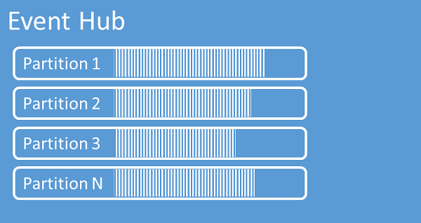
Partitions
Data organization mechanism
Specified at creation – NOT CHANGABLE
Between 2 and 32, default is 2 (32 is soft limit)

Slide 16
How does Event Hubs Scale
Throughput Unit (TU)
Variable reserved capacity
This is the component you purchase
1 MB/s or 1,000 events/s ingress
2 MB/s or 2,000 events/s egress
Namespace wide – across Event Hubs
Overages are throttled (ServerBusyException)
Available in
1 – 20 TUs hourly
Blocks of 20 up to 100 with support ticket
Additional options?
Should be less than or equal to the number of partitions

Slide 17
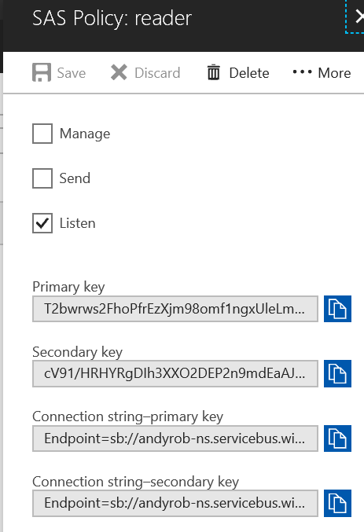
Event Hub Policies
Enables authentication to the service
Configuration of permissions
Example Connection String:
Endpoint=sb://andyrob-ns.servicebus.windows.net/;SharedAccessKeyName=reader;SharedAccessKey=XXXXXXXXXXXXXXXXXXXXXXXXXXX=;EntityPath=andyrob-eh
Notes:
Maximum of 12 per Service Bus namespace

Slide 18
How to Interact with Event Hubs
Azure Web Portal
Azure SDK
PowerShell
Service Bus Explorer

Slide 19
Event Hub Code
static void SendingRandomMessages()
{
var eventHubClient = EventHubClient.CreateFromConnectionString(connectionString, eventHubName);
while (true)
{
try
{
var message = Guid.NewGuid().ToString();
Console.WriteLine("{0} > Sending message: {1}", DateTime.Now, message);
eventHubClient.Send(new EventData(Encoding.UTF8.GetBytes(message)));
}
catch (Exception exception)
{
Console.ForegroundColor = ConsoleColor.Red;
Console.WriteLine("{0} > Exception: {1}", DateTime.Now, exception.Message);
Console.ResetColor();
}
Thread.Sleep(200);
}
}
Notes:
Example of using the SDK, with VS.
This method continuously sends events to your Event Hub with a 200-ms delay.

Slide 20
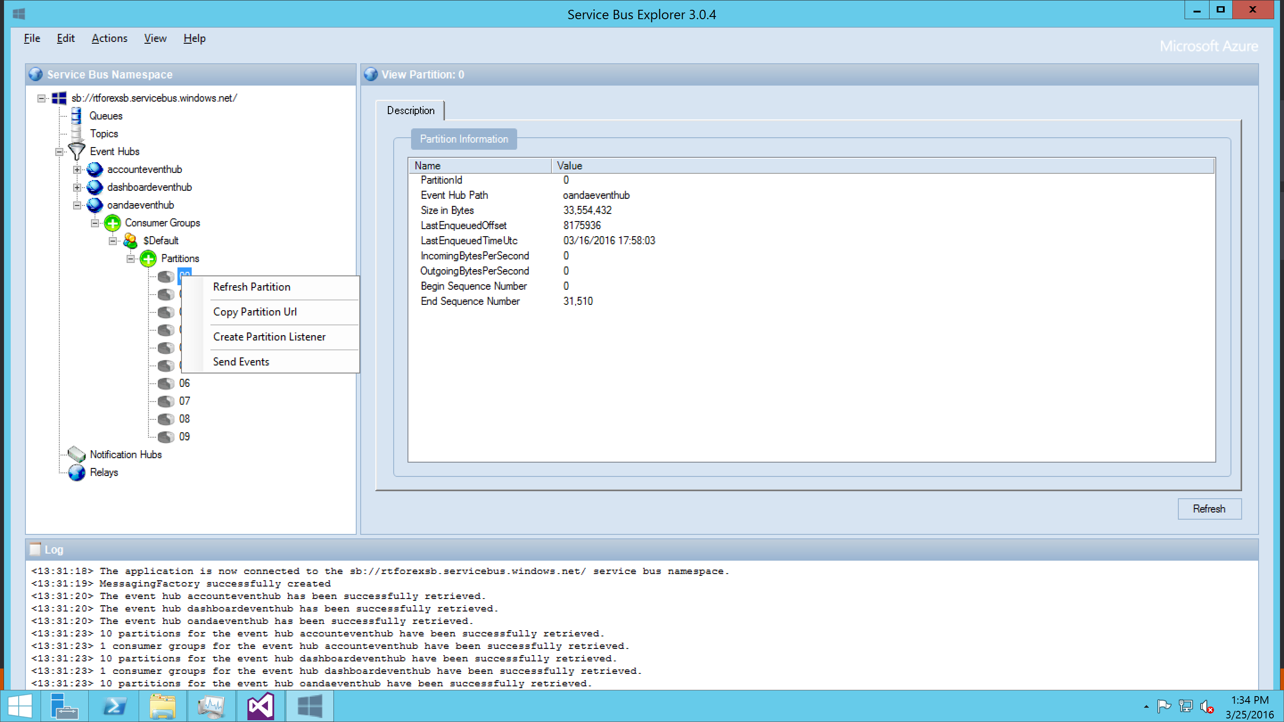
Service Bus Explorer

Slide 21
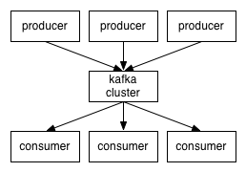
Apache Kafka
Open Source publish-subscribe
One broker can handle 100’s of MB/sec from 1000’s of clients
Elastic scale
Cluster centric design for fault tolerance

Slide 22
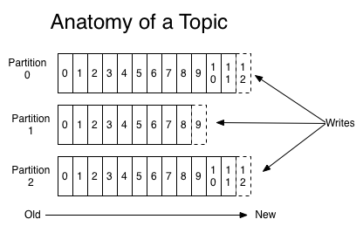
Topics and Logs
Topic: Category or feed name
Log: partition within a topic
Notes:
A topic is a category or feed name to which messages are published. For each topic, the Kafka cluster maintains a partitioned log that looks like this diagram
Each partition is an ordered, immutable sequence of messages that is continually appended to—a commit log.
The offset is controlled by the consumer: normally a consumer will advance its offset linearly as it reads messages, but in fact the position is controlled by the consumer and it can consume messages in any order it likes. For example a consumer can reset to an older offset to reprocess.

Slide 23
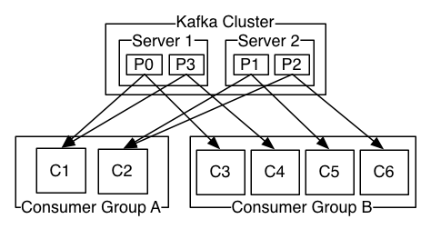
Distribution, Producers & Consumers
Partitions are distributed over configurable number of servers (1 leader and n followers)
Producer is responsible for assigning messages to partitions
Round robin
Semantic partition function
Each consumer belongs to a consumer group
Each partition can have multiple consumer groups
Notes:
Distribution
The partitions of the log are distributed over the servers in the Kafka cluster with each server handling data and requests for a share of the partitions. Each partition is replicated across a configurable number of servers for fault tolerance. Each partition has one server which acts as the "leader" and zero or more servers which act as "followers". The leader handles all read and write requests for the partition while the followers passively replicate the leader. If the leader fails, one of the followers will automatically become the new leader. Each server acts as a leader for some of its partitions and a follower for others so load is well balanced within the cluster.
Producers
Producers publish data to the topics of their choice. The producer is responsible for choosing which message to assign to which partition within the topic. This can be done in a round-robin fashion simply to balance load or it can be done according to some semantic partition function (say based on some key in the message).
Consumers
Consumers label themselves with a consumer group name, and each message published to a topic is delivered to one consumer instance within each subscribing consumer group. Consumer instances can be in separate processes or on separate machines.
If all the consumer instances have the same consumer group, then this works just like a traditional queue balancing load over the consumers.
If all the consumer instances have different consumer groups, then this works like publish-subscribe and all messages are broadcast to all consumers.
More commonly, however, we have found that topics have a small number of consumer groups, one for each "logical subscriber". Each group is composed of many consumer instances for scalability and fault tolerance. This is nothing more than publish-subscribe semantics where the subscriber is a cluster of consumers instead of a single process.

Slide 24
More information on Kafka
http://kafka.apache.org/
Use Cases
Documentation
Architectures
Configurations
Ecosystem
etc.

Slide 25
In this module
Lambda Architecture
Event Hubs & Kafka
Storm
Stream Analytics
Spark

Slide 26
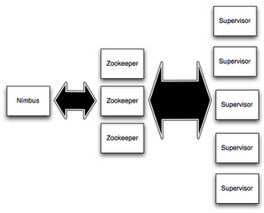
Storm Components
Nimbus
Master Node
Responsible for distributing code around the cluster, assigning tasks to machines, and monitoring for failures
Supervisor
Worker Node
Listens for work assigned to its machine and starts and stops worker processes
worker process executes a subset of a topology
Notes:
The best way to look at this is through an analogy to push notifications to your mobile devices.
An applications needs to tell you something, but you have it installed on many devices. If you check the notification on one, you don’t want to read it over and over again on each of your other devices.
Queues delete the messages after they’ve been read once, and has protocols in place to make sure that the message isn’t deleted prematurely, to avoid data loss.

Slide 27
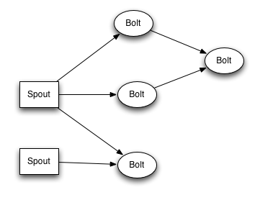
Storm Components
Topology
Defines a graph of computation that processes streams of data. Unlike MapReduce jobs, topologies run until you stop them.
Spout
Consumes data from a data source and emits one or more streams.
Bolt
Consumes streams, performs processing, and may emit streams for further processing.
Responsible for writing data to external storage, HDInsight HBase, a blob, or other data store
Notes:
Topics are most commonly used when each user doesn’t need to see every single message that’s being pushed through by a sender.
It helps streamline business operations by allowing users to subscribe to what they need, and then only delivering that relevant content.
The messages, however, are handled in the same way as in queues. They are formatted the same, and are stored/deleted the same way.

Slide 28
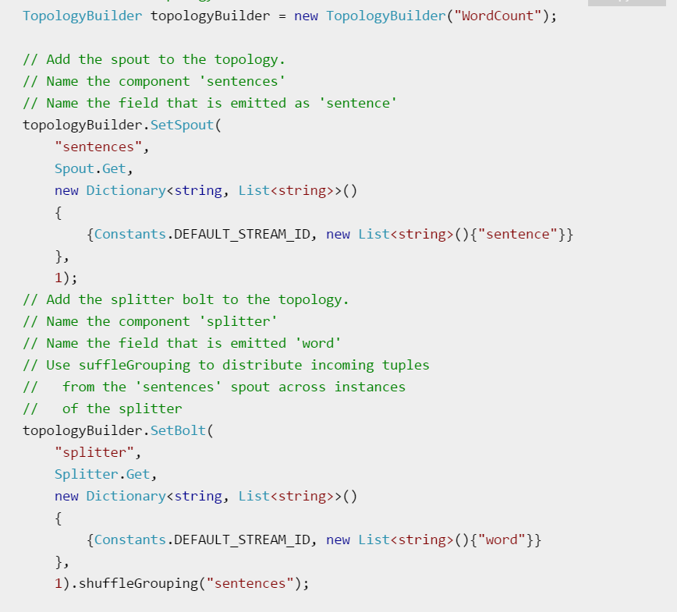
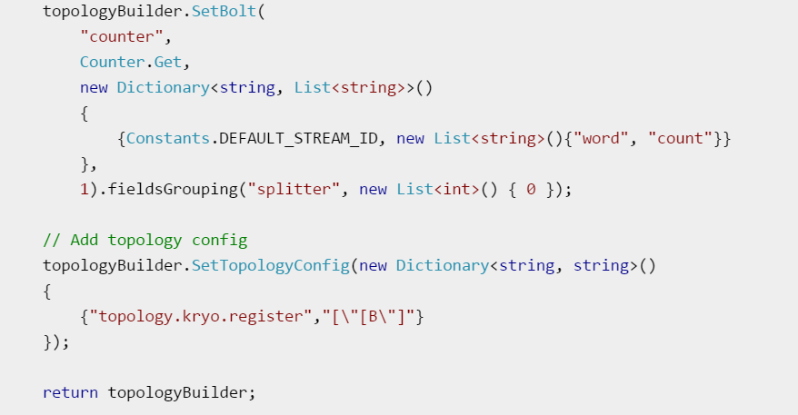
Storm Topology
Objects Needed
TopologyBuilder
setSpout/setBolt
Shufflegrouping
Cluster config
Cluster
Notes:
Topics are most commonly used when each user doesn’t need to see every single message that’s being pushed through by a sender.
It helps streamline business operations by allowing users to subscribe to what they need, and then only delivering that relevant content.
The messages, however, are handled in the same way as in queues. They are formatted the same, and are stored/deleted the same way.

Slide 29
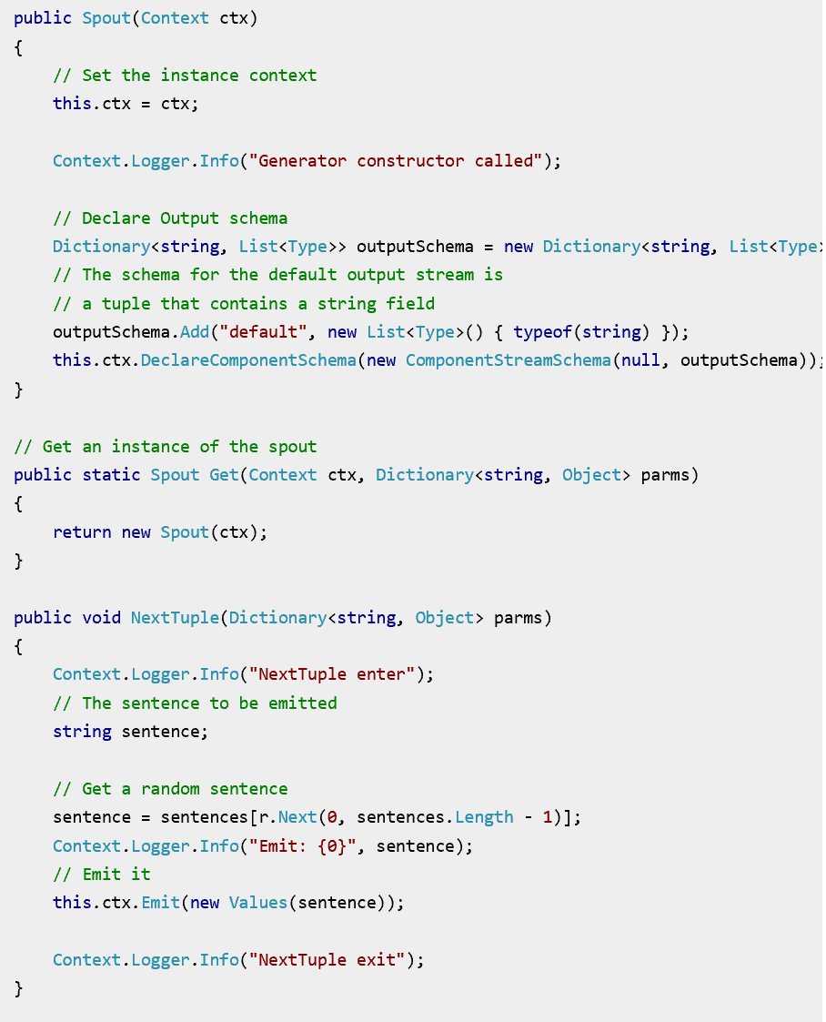
Storm Spout
Spout
Consumes data from a data source and emits one or more streams.
Notes:
Topics are most commonly used when each user doesn’t need to see every single message that’s being pushed through by a sender.
It helps streamline business operations by allowing users to subscribe to what they need, and then only delivering that relevant content.
The messages, however, are handled in the same way as in queues. They are formatted the same, and are stored/deleted the same way.

Slide 30
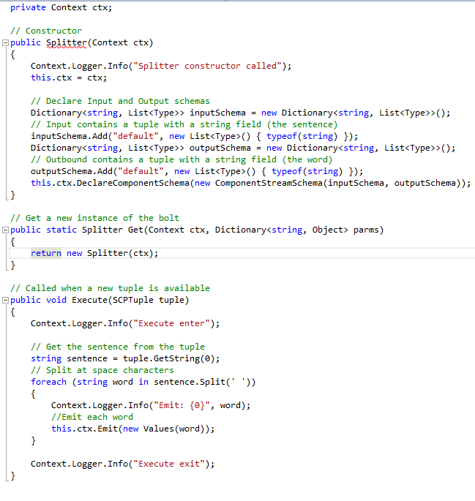
Storm Bolt
Bolt
Consumes streams, performs processing, and may emit streams for further processing.
Responsible for writing data to external storage, HDInsight HBase, a blob, or other data store
Notes:
Topics are most commonly used when each user doesn’t need to see every single message that’s being pushed through by a sender.
It helps streamline business operations by allowing users to subscribe to what they need, and then only delivering that relevant content.
The messages, however, are handled in the same way as in queues. They are formatted the same, and are stored/deleted the same way.

Slide 31
In this module
Lambda Architecture
Event Hubs & Kafka
Storm
Stream Analytics
Spark

Slide 32
Stream Analytics
Simple Real Time ETL (movement of Data)
Rapid development
SQL based syntax
Automatic distribution for scale, performance and resiliency
Compares multiple streams, detects anomalies
Triggers alerts
Displays real time dashboards

Slide 33
Anatomy
Consumer Groups
One per input
Inputs
Blob storage
Event Hubs
IoT Hubs
Query
SQL-Like Language - https://azure.microsoft.com/en-us/documentation/articles/stream-analytics-stream-analytics-query-patterns/
Outputs
Azure Data Lake Store
SQL DB
Blob storage
Event Hub
PowerBI
Table Storage
Service Bus Queues
Service Bus Topics
DocumentDB

Slide 34
Language & Library
DML(Data Manipulation Language)
SELECT
FROM
WHERE
GROUP BY
HAVING
CASE WHEN THEN ELSE
INNER/LEFT OUTER JOIN
UNION
CROSS/OUTER APPLY
CAST
INTO
ORDER BY ASC, DSC
Date and Time Functions
DateName, DatePart, Day
Month, Year, DateDiff
DateTimeFromParts, DateAdd
Aggregate Functions
SUM
COUNT
AVG
MIN
MAX
STDEV
STDEVP
VAR
VARP
TopOne
Mathematical Functions
ABS, CEILING, EXP, FLOOR
POWER, SIGN, SQUARE
SQRT
Temporal Functions
Lag, IsFirst,Last
CollectTop
String Functions
Len, Concat, CharIndex
Substring, Lower
Upper, PatIndex
Scaling Extensions
WITH
PARTITION BY
OVER
Windowing Extensions
TumblingWindow
HoppingWindow
SlidingWindow
Notes:
34:00
Let’s take a quick look at the ASA language – Stream Analytics Query Language
A fair subset of T-SQL, extended with temporal concepts and dynamic schema

Slide 35
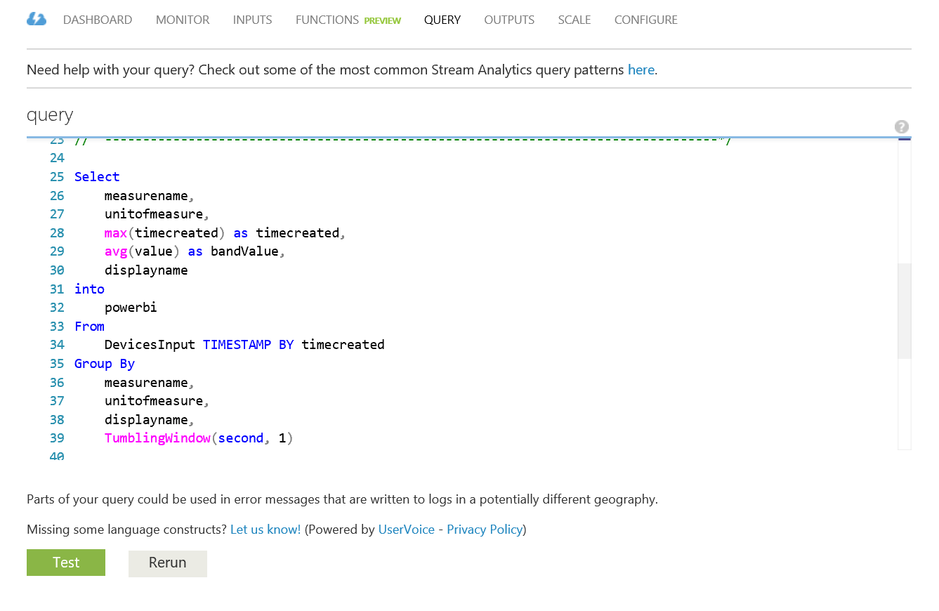
Stream Analytics Sample Query

Slide 36
Events and Time
Every event that flows through the system has a timestamp
User can pick it from the payload
SELECT * FROM TwitterStream TIMESTAMP BY CreatedAt
Or the system can assign timestamps automatically based on the event arrival time
SELECT * FROM TwitterStream
Projecting timestamp into payload
SELECT System.Timestamp AS Time, Text FROM TwitterStream
Note: System.Timestamp is a reserved property that exposes the timestamp of an event.
Notes:
Please note that in this case the value of the timestamp is potentially subject to factors such as network latencies.

Slide 37
Tumbling Windows
Tell me the count of tweets per time zone every 10 seconds
A 10-second Tumbling Window
1
5
4
6
2
8
6
5
3
6
1
0
5
10
15
20
25
30
Time
(secs)
1
5
4
6
2
8
6
5
3
6
1
SELECT TimeZone, COUNT(*) AS Count
FROM TwitterStream TIMESTAMP BY CreatedAt
GROUP BY TimeZone, TumblingWindow(second,10)
Notes:
Tumbling windows:
Repeat
Are non-overlapping
An event can belong to only one tumbling window

Slide 38
Hopping Windows
A 10-second Hopping Window with a 5-second “Hop”
Every 5 seconds give me the count of tweets over the last 10 seconds
1
5
4
6
2
8
7
5
3
6
1
0
5
10
15
20
25
30
Time
(secs)
1
5
4
6
2
4
6
2
8
7
8
7
5
3
5
3
6
1
SELECT Topic, COUNT(*) AS TotalTweets
FROM TwitterStream TIMESTAMP BY CreatedAt
GROUP BY Topic, HoppingWindow(second, 10 , 5)
Notes:
Hopping windows:
Hop forward in time by a fixed period
Repeat
Can overlap
Same as tumbling window if hop size = window size
Events can belong to more than one hopping window

Slide 39
Sliding Windows
A 10-second Sliding Window
1
5
9
8
Give me the count of tweets for all topics which are tweeted more than 10 times in the last 10 seconds
0
5
10
15
20
25
Time
(secs)
1
1
5
1
5
9
8
SELECT Topic, COUNT(*) FROM TwitterStream
TIMESTAMP BY CreatedAt
GROUP BY Topic, SlidingWindow(second, 10)
HAVING COUNT(*) > 10
Notes:
Sliding window:
Continuously moves forward by an € (epsilon)
Produces an output only during the occurrence of an event
Every windows will have at least one event
Events can belong to more than one sliding window

Slide 40
In this module
Lambda Architecture
Event Hubs & Kafka
Storm
Stream Analytics
Spark

Slide 41
Apache Spark
Fast, distributed, scalable and fault tolerant cluster compute system
Enables Low-latency with complex analytics
10x faster on disk,100x faster in memory than Hadoop MR
Hadoop, Mesos, standalone
Fault Tolerant Distributed Datasets
Batch, iterative and streaming analysis
In Memory Storage and Disk
Integrates with Most File and Storage Options
Java, Scala, Python, R. Functional Programming model. Use from REPL.
Write, test and maintain 2 - 5x less code
Libraries for SQL, Machine Learning, Graph and streaming

Slide 42
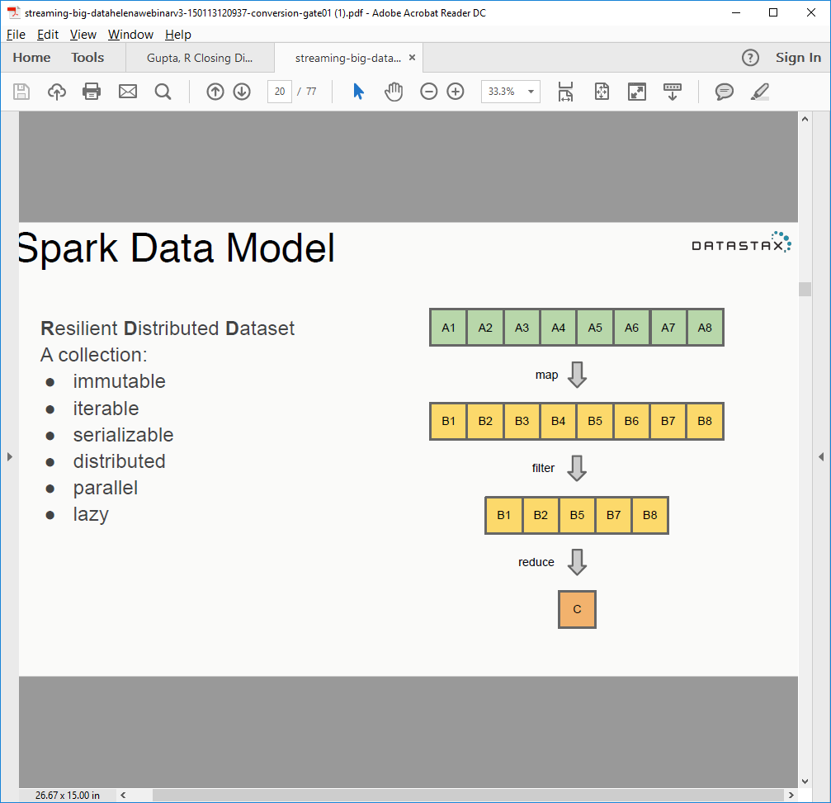
Resilient Distributed Dataset (RDD)
Fault Tolerant: can recalculate from any point of failure
Created through transformations on data ( map, filter..) or other RDDs
Immutable
Partitioned - Indicate which RDD elements to partition across machines based on a key in each record
Can be reused
Transformation
Action

Slide 43
Spark Examples
Collection To RDD
scala> val data = Array(1, 2, 3, 4, 5)
data: Array[Int] = Array(1, 2, 3, 4, 5)
scala> val distData = sc.parallelize(data)
distData: spark.RDD[Int] =
spark.ParallelCollection@10d13e3e
/** Returns the top (k) highest temps for any location in the `year`. */
val k = 20
def topK(aggregate: Seq[Double]): Seq[Double] =
sc.parallelize(aggregate).top(k)
/** Returns the top (k) highest temps … in a Future */
def topK(aggregate: Seq[Double]): Future[Seq[Double]] =
sc.parallelize(aggregate).top(k).collectAsync
Easy to Use API
val conf = new SparkConf()
.setMaster("local[*]")
.setAppName("Simple Word Count")
val sc = new SparkContext(conf)
sc.textFile(words)
.flatMap(_.split("\\s+"))
.map(word => (word.toLowerCase, 1))
.reduceByKey(_ + _)
.collect foreach println
Basic Word Count

Slide 44
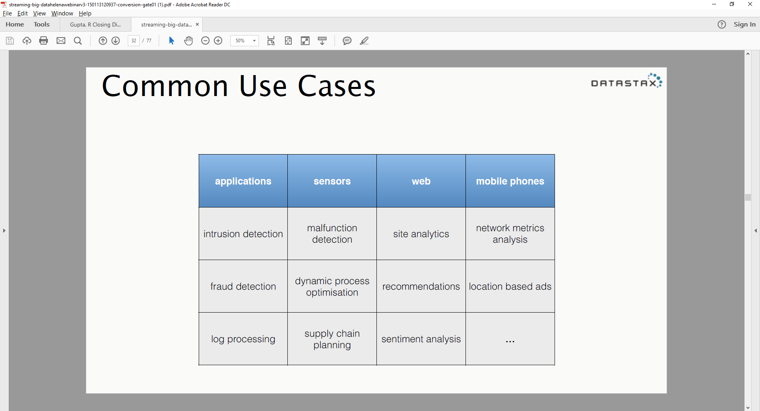
Spark Use Cases
Interactive Data Analysis and BI
Iterative Machine Learning
Streaming and Real Time data analysis

Slide 45
Reporting Tools with Spark
Power BI
https://azure.microsoft.com/en-us/documentation/articles/hdinsight-apache-spark-use-bi-tools/
Zeppelin
https://azure.microsoft.com/en-us/documentation/articles/hdinsight-apache-spark-use-zeppelin-notebook/
Jupyter/ iPython Notebook
https://azure.microsoft.com/en-us/documentation/articles/hdinsight-apache-spark-jupyter-notebook-install-locally/

